Slide 1
Image Recognition Using Convolutional Neural Networks
Group 4: Jose German, Anupama Radhakrishnan Kowsalya, Anjana Pradeep Kumar, and Xenel Nazar
Notes:
Good Day Hashmat, we are Group 4 and our team consists of Jose German, Anupama Radhakrishnan Kowsalya, Anjana Pradeep Kumar, and myself Xenel Nazar. Today we are going to talk about Image Recognition using convolutional neural networks

Slide 2
AGENDA
Overview
Data Analysis
Data Pre-processing
Modelling & Evaluation
Deployment & Conclusions
Notes:
We conducted our project and this presentation, following the CRISP DM framework.
First of all, we will go through an overview. Then, the underlying analysis done on the raw data. The data processing steps conducted to prepare for modelling. Next, we will discuss how we developed our model and adjustments we made to improve the model. Lastly, we will demo our Shiny app currently deployed on shinyapps.io and conclude on details of any improvements.

Slide 3
OVERVIEW
HIP (Human Interaction Proof)
CAPTCHA (Completely Automated Public Turing test to tell Computers and Humans Apart)
Designed to be challenges easily solved by Humans, but difficult for computers or bots to solve
ESP-PIX CAPTCHA
Source: (Basso & Bergadano, 2010)
Notes:
Various web services deploy security measures, like Human Interaction Proof (HIP) systems that are designed to be challenges easily solved by Humans, but difficult for computers or bots to solve
One popular Human Interaction Proof implementation is CAPTCHA. For example The ESP-PIX Captcha shown on the slide asks the user answer what the images shown can be classified as which in this case would be cats.

Slide 4
APPLICATIONS OF CAPTCHA
Preventing Comment Spam in Blogs
Protecting Website Registration
Protecting Email Addresses From Scrapers
Online Polls
Preventing Dictionary Attacks
Search Engine Bots.
Worms and Spam
Source: (Carnegie Mellon University, 2010)
Notes:
CAPTCHAs can be applied in multiple cases, including preventing comments spam in blogs, protecting website registration, protecting email addresses from scrapers, online polls, preventing dictionary attacks in password systems, blocking search engine bots, as well blocking email worms and spam. The ESP-PIX Captcha script implementation is based on image recognition, where users are asked to review and recognize similar or common set of images (Carnegie Mellon University, 2010).
The recent advancement and popularity of deep learning algorithms point to a question, if models can be developed that would be able to circumvent HIP systems like the ESP-PIX Captcha implementation.

Slide 5
ABOUT THE DATA
The ASIRRA (Animal Species Image Recognition for Restricting Access) dataset contains 25000 images of Cats and Dogs
Medium resolution color JPEGs
Notes:
This dataset contains 25,000 images of dogs and cats (12,500 from each class) and is 543 MB (compressed). After downloading and uncompressing it, we have created a new dataset containing three subsets: a training set with 1,000 samples of each class, a validation set with 500 samples of each class, and a test set with 500 samples of each class.
Each split contains the same number of samples from each class: this is a balanced binary-classification problem, which means classification accuracy will be an appropriate measure of success.

Slide 6
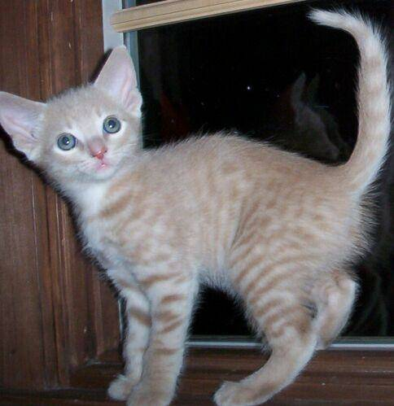
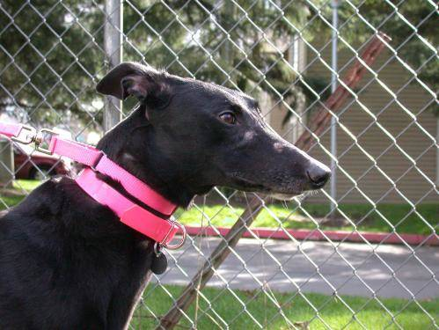
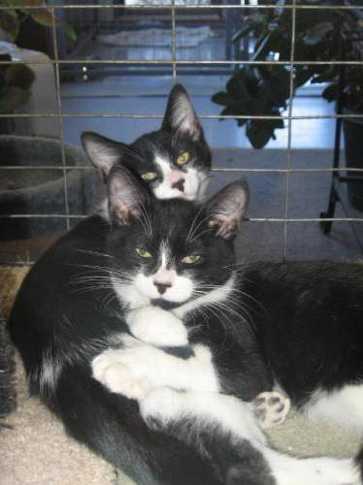
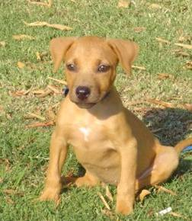
DATA EXAMPLES
Notes:
Samples from the Dogs vs. Cats dataset. Sizes weren’t modified: the samples are heterogeneous in size, appearance, and so on.

Slide 7
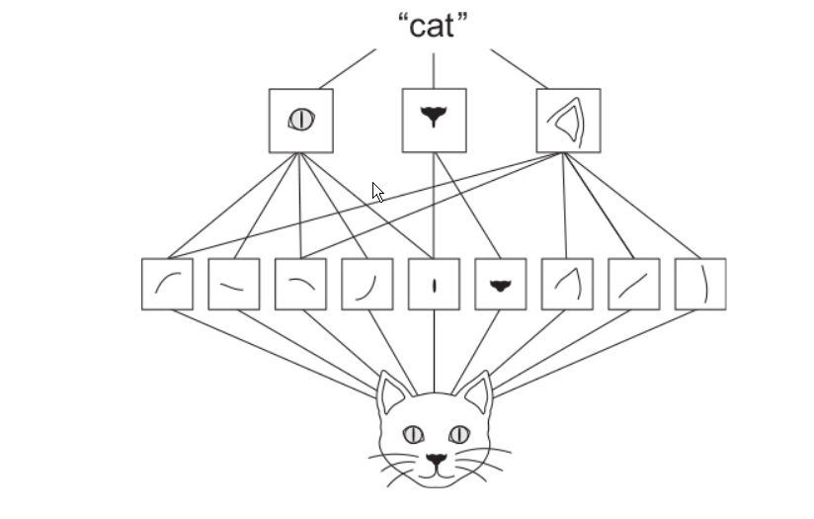
FEATURE EXTRACTION
The visual world forms a spatial hierarchy of visual modules: hyperlocal edges combine into local objects such as eyes or ears, which combine into high-level concepts such as “cat”.

Slide 8
DATA PRE-PROCESSING
Read the picture files
Decode the JPEG content to RGB grids of pixels
Convert these into floating-point tensors
Rescale the pixel values (between 0 and 255) to the [0, 1] interval
Resizes all images to 150 × 150
Because of binary_crossentropy loss, binary labels are needed
Notes:
Keras has utilities to take care of these steps automatically. Keras includes a number of image-processing helper tools. In particular, it includes the image_data_generator() function, which can automatically turn image files on disk into batches of preprocessed tensors. 1 Rescales all images by 1/255
2 Target directory
3 Training data generator
4 Resizes all images to 150 × 150
5 Because you use binary_crossentropy loss, you need binary labels.
So, output of one of these generators yields batches of 150 × 150 RGB images (shape (20, 150, 150, 3)) and binary labels (shape (20)). There are 20 samples in each batch (the batch size). Note that the generator yields these batches indefinitely—it loops endlessly over the images in the target folder:

Slide 9
CONVOLUTIONAL NEURAL NETWORKS
Inspired by the organization of animal visual cortex
Spatial Hierarchy of features through Back propagation
Dominant in computer vision tasks
Convolution, pooling, and fully connected layers

Slide 10
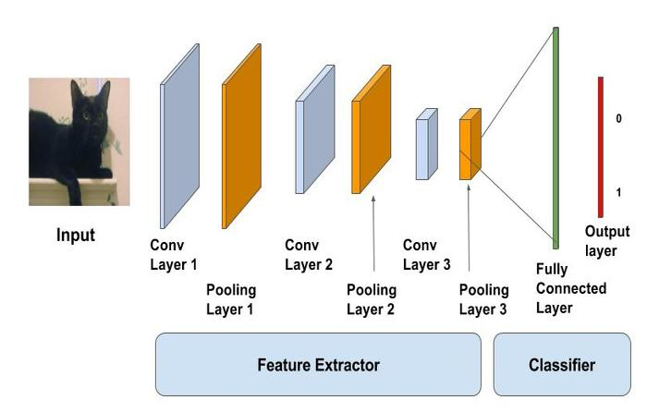
CONVOLUTIONAL NETWORK LAYERS
Source: (Gupta & Murzova, 2017)

Slide 11
CNN BUILDING BLOCKS
Convnets are the fundamental component that perform feature extraction
Convolutions operate over 3D tensors, called feature maps, with two spatial axes (height and width) as well as a depth axis (also called the channels axis).
Non linear activation function(ReLU)
Max pooling Operation - Extracts features from the input feature maps and outputs the maximum value of each channel.
Fully connected layer(dense layer)-Final convolution layer or pooling layer is flattened to one dimensional array
Notes:
convolutional neural networks, also known as convnets, a type of deep-learning model almost universally used in computer vision applications. Importantly, a convnet takes as input tensors of shape (image_height, image_width, image_channels)
Max pooling Opeartion - consists of extracting windows from the input feature maps and outputting the max value of each channel. It’s conceptually similar to convolution, except that instead of transforming local patches via a learned linear transformation (the convolution kernel), they’re transformed via a hardcoded max tensor operation.
A big difference from convolution is that max pooling is usually done with 2 × 2 windows and stride 2, in order to downsample the feature maps by a factor of 2. On the other hand, convolution is typically done with 3 × 3 windows and no stride (stride 1).
The reason to use downsampling is to reduce the number of feature-map coefficients to process, as well as to induce spatial-filter hierarchies by making successive convolution layers look at increasingly large windows

Slide 12
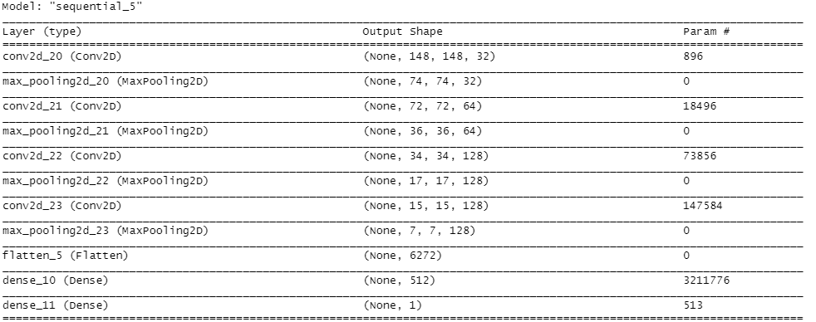
MODEL
The depth of the feature maps progressively increases in the network (from 32 to 128), whereas the size of the feature maps decreases (from 148 × 148 to 7 × 7).
Notes:
Let’s fit the model to the data using the generator. You do so using the fit_generator function, the equivalent of fit for data generators like this one. It expects as its first argument a generator that will yield batches of inputs and targets indefinitely, like this one does. Because the data is being generated endlessly, the fitting process needs to know how many samples to draw from the generator before declaring an epoch over. This is the role of the steps_per_epoch argument: after having drawn steps_per_epoch batches from the generator—after having run for steps_per_epoch gradient descent steps—the fitting process will go to the next epoch. In this case, batches are 20 samples, so it will take 100 batches until you see your target of 2,000 samples.
When using fit_generator, you can pass a validation_data argument, much as with the fit function. It’s important to note that this argument is allowed to be a data generator, but it could also be a list of arrays. If you pass a generator as validation_data, then this generator is expected to yield batches of validation data endlessly; thus you should also specify the validation_steps argument, which tells the process how many batches to draw from the validation generator for evaluation.

Slide 13
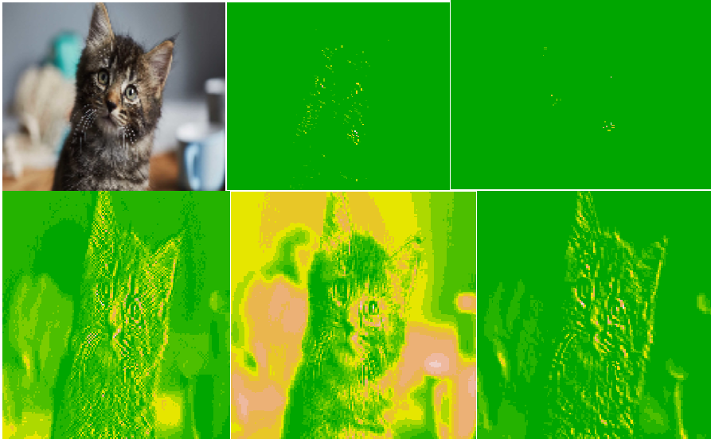
ACTIVATION LAYERS AND PREDICTION
Prediction Score :0.508
Prediction :Class 0
Notes:
Let’s plot the loss and accuracy of the model over the training and validation data during training. These plots are characteristic of overfitting. The training accuracy increases linearly over time, until it reaches nearly 100%, whereas the validation accuracy stalls at 71%–75%. The validation loss reaches its minimum after only five epochs and then stalls, whereas the training loss keeps decreasing linearly until it reaches nearly 0.
Because you have relatively few training samples (2,000), overfitting will be your number-one concern. You already know about a number of techniques that can help mitigate overfitting, such as dropout and weight decay (L2 regularization). We’re now going to work with a new one, specific to computer vision and used almost universally when processing images with deep-learning models: data augmentation

Slide 14
DATA AUGMENTATION
To avoid overfitting
Approach of generating more training data from existing training samples, by augmenting the samples via a number of random transformations that yield believable-looking images
Model will never see the exact same picture twice, helps expose the model to more aspects of the data
Notes:
Overfitting is caused by having too few samples to learn from, rendering you unable to train a model that can generalize to new data. Given infinite data, your model would be exposed to every possible aspect of the data distribution at hand: you would never overfit. Data augmentation takes the approach of generating more training data from existing training samples, by augmenting the samples via a number of random transformations that yield believable-looking images. The goal is that at training time, your model will never see the exact same picture twice. This helps expose the model to more aspects of the data and generalize better.
In Keras, this can be done by configuring a number of random transformations to be performed on the images read by an image_data_generator. Let’s get started with an example.

Slide 15
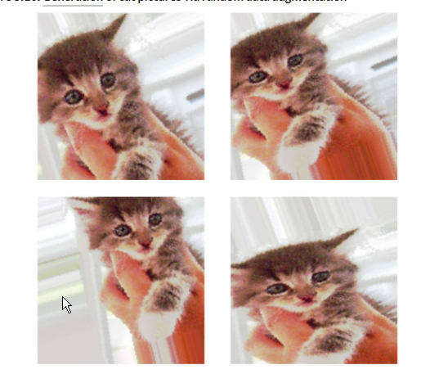
DATA AUGMENTATION EXAMPLE
Choose one image to augment
Read the image and resizes it
Convert it to an array with shape (150, 150, 3)
Reshape it to (1, 150, 150, 3)
Generate batches of randomly transformed images
Loops indefinitely, so a breakpoint is needed
Plot the images
Notes:
In Keras, this can be done by configuring a number of random transformations to be performed on the images read by an image_data_generator.
Let’s get started with an example. rotation_range is a value in degrees (0–180), a range within which to randomly rotate pictures. width_shift and height_shift are ranges (as a fraction of total width or height) within which to randomly translate pictures vertically or horizontally. shear_range is for randomly applying shearing transformations zoom_range for rabdomly zooming inside pictures horizontal_flip is for arandomly flipping half the images horizontally. fill_mode is the strategy used for filling in newly created pixels, which can appear after a rotation or a width/height shift. Let’s look at the augmented images . If you train a new network using this data-augmentation configuration, the network will never see the same input twice.

Slide 16
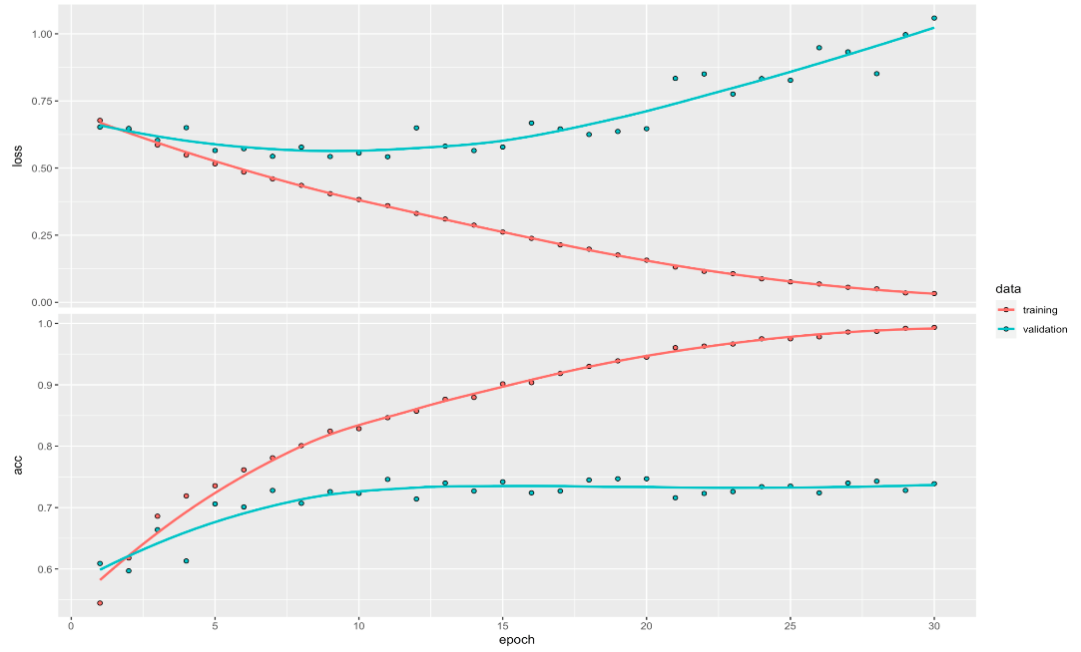
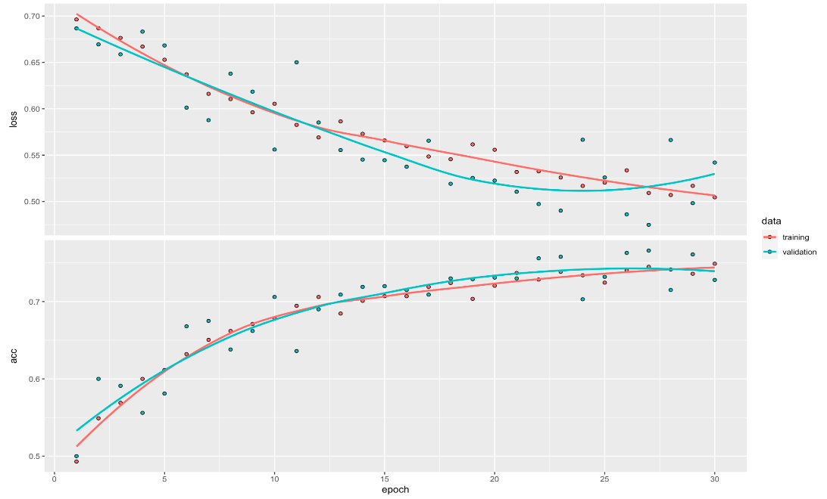
ACCURACY AND LOSS CURVE
Before Data Augmentation
After Data Augmentation
Notes:
Let’s plot the loss and accuracy of the model over the training and validation data during training. These plots are characteristic of overfitting. The training accuracy increases linearly over time, until it reaches nearly 100%, whereas the validation accuracy stalls at 71%–75%. The validation loss reaches its minimum after only five epochs and then stalls, whereas the training loss keeps decreasing linearly until it reaches nearly 0.
After data augmentation , you will now see the accuracy curve has increased and loss is reduced.

Slide 17

DEPLOYMENT
Link: https://jose-g.shinyapps.io/catsdogs

Slide 18
CONCLUSION
Effectiveness of CNN models at classifying images used in HIP or CAPTCHA systems pose a risk
Image HIP systems can improve security by:
Using a diverse set of images
Implement use of other mediums (e.g. Video, Audio)
Implementing interactive challenges
Frequent refresh of data used
Future work – Improve Accuracy
Use of pre-trained networks & fine-tuned pre-trained models
Notes:
CAPTCHA or HIP systems using images are no longer effective as a security solution to stop spam or computer bots. Deep Learning implementations such as Convolutional Neural Networks can effectively classify images that it has been trained on.
Those that deploy image classifying HIP or CAPTCHA systems, can take certain steps to improve the overall security of end users. First, HIP systems can use a diverse set of images. Images of various subjects like various other animals or objects would decrease the overall accuracy of convolutional neural networks if the subject was not included in the training data. HIP systems can also include other mediums, such as video and audio clips, as this may be more of a challenge to program model in spam bots. Another option is to implement interactive elements to HIP or CAPTCHA systems that require users to interact with objects, like moving segments of a picture to complete a puzzle.
Future work to improve the accuracy would be to use pre-trained networks & fine-tuned pre-trained models.
Lastly, the underlying data used in image HIP or CAPTCHA systems would need to have frequent or recurring refreshes and reviews to determine overall effectiveness at ensuring the security of the end users.

Slide 19
REFERENCES
Allaire, J. (2020). TensorFlow for R - Basic Image Classification. Retrieved July 10, 2020, from https://tensorflow.rstudio.com/tutorials/beginners/basic-ml/tutorial_basic_classification/
Basso, A., & Bergadano, F. (2010). Anti-bot Strategies Based on Human Interactive Proofs. 10.1007/978-3-642-04117-4_15.
Brownlee, J. (2019, July 05). How to Configure Image Data Augmentation in Keras. Retrieved July 10, 2020, from https://machinelearningmastery.com/how-to-configure-image-data-augmentation-when-training-deep-learning-neural-networks/
Brownlee, J. (2019, September 13). Dropout Regularization in Deep Learning Models With Keras. Retrieved July 10, 2020, from https://machinelearningmastery.com/dropout-regularization-deep-learning-models-keras/
Carnegie Mellon University. (2010). CAPTCHA: Telling Humans and Computers Apart Automatically. Retrieved July 10, 2020, from http://www.captcha.net/
Chellapilla, K., Larson, K., Simard, P., & Czerwinski, M. (2018, October 17). Designing Human Friendly Human Interaction Proofs (HIPS). Retrieved July 10, 2020, from https://www.microsoft.com/en-us/research/publication/designing-human-friendly-human-interaction-proofs-hips/
Chollet, F., & Allaire, J. J. (2018). Deep learning for computer vision. In Deep Learning with R. Shelter Island, NY: Manning Publications. Retrieved July 10, 2020, from https://livebook.manning.com/book/deep-learning-with-r/chapter-5
Cukierski, W. (2014). Dogs vs. Cats. Retrieved July 10, 2020, from https://www.kaggle.com/c/dogs-vs-cats/data
Gupta, V., & Murzova, A. (2017, November 29). Image Classification using Convolutional Neural Networks in Keras. Retrieved July 10, 2020, from https://www.learnopencv.com/image-classification-using-convolutional-neural-networks-in-keras/
Microsoft. (2017, October 2). Kaggle Cats and Dogs Dataset. Retrieved July 10, 2020, from https://www.microsoft.com/en-us/download/details.aspx?id=54765
Petfinder.com. (2018, June 22). About Petfinder. Retrieved July 10, 2020, from https://www.petfinder.com/about/

Slide 20
THANK YOU

